Slide 1
Predictive Analysis of Drug Overdose Deaths
An Insightful Dive into Substance Abuse Data

Slide 2
Introduction
The opioid crisis in the United States has led to a significant increase in drug overdose deaths. Predictive modeling offers insights into patterns and helps design effective interventions.

Slide 3
Dataset Overview
Years: 2012-2018
Number of Records: 5,100
Key Features: Age, Sex, Race, Substances Involved
Target Variable: Presence of Fentanyl

Slide 4
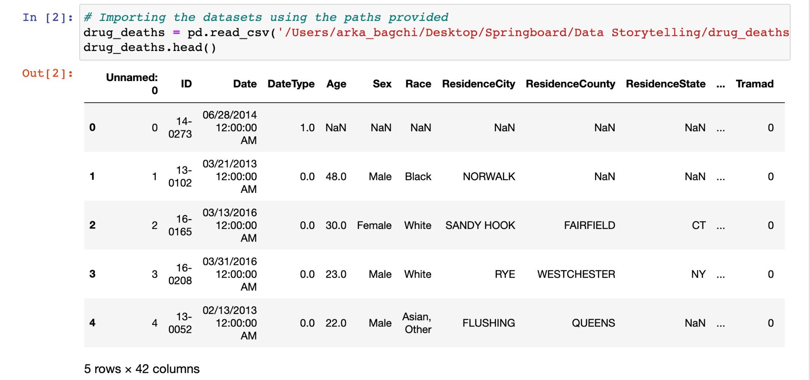
Initial Dataset

Slide 5
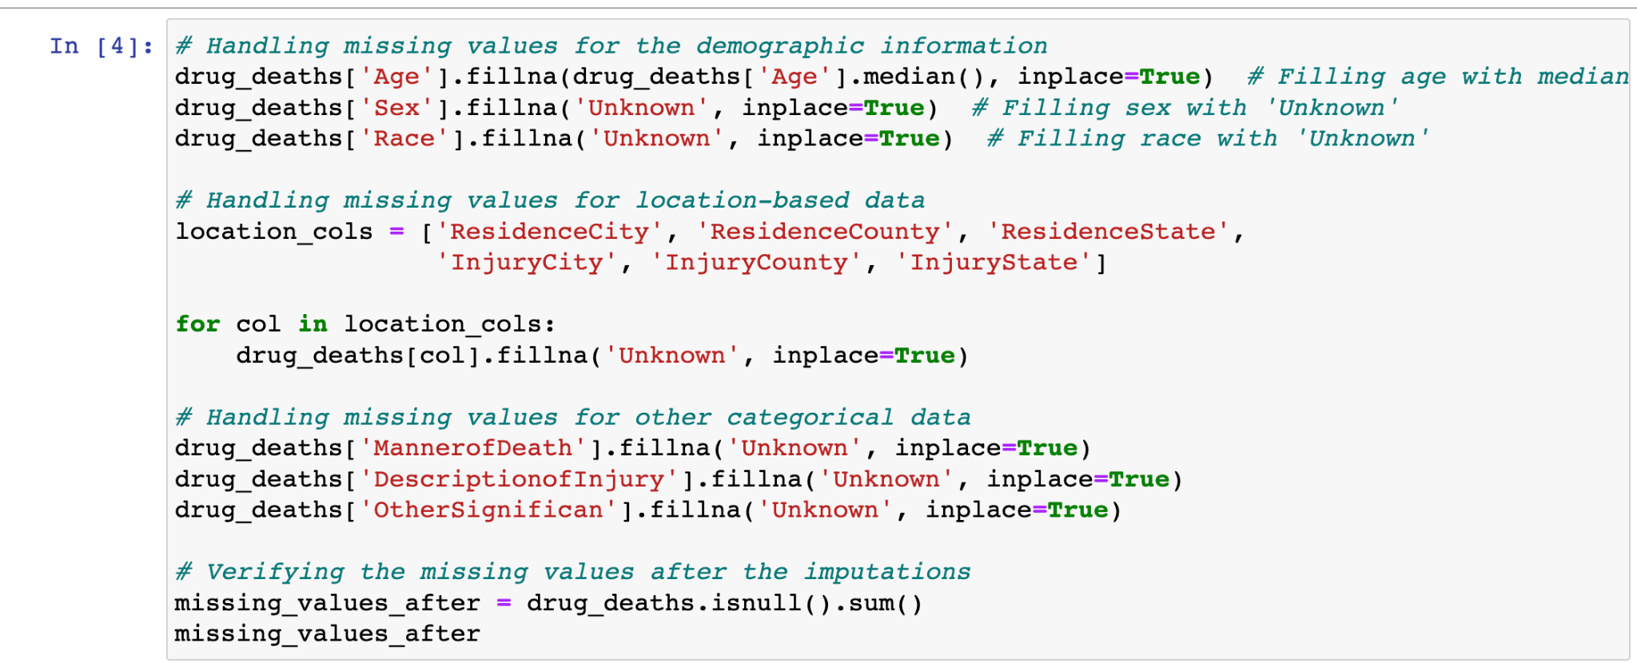
Data Wrangling / Cleaning
Handled missing values, dropped irrelevant columns, and imputed missing values where necessary.

Slide 6
Exploratory Data Analysis (EDA)
Explored distributions, relationships, and trends in the data.

Slide 7
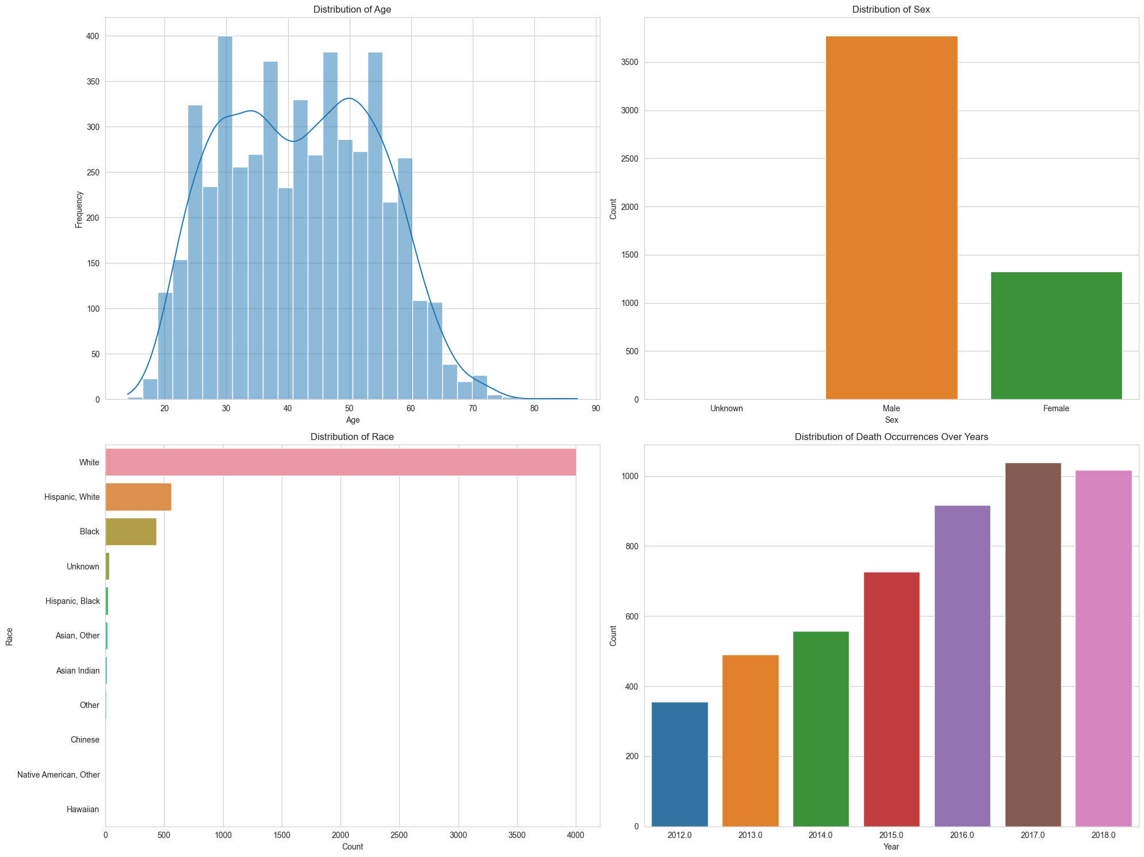

Slide 8
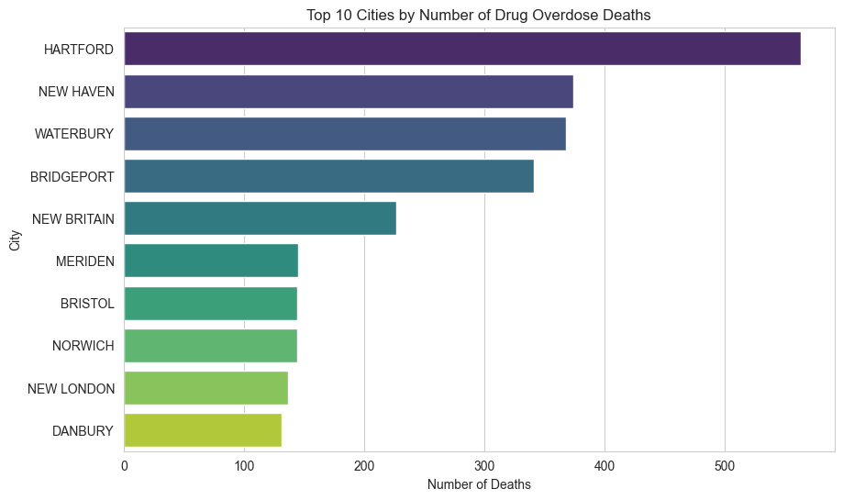

Slide 9
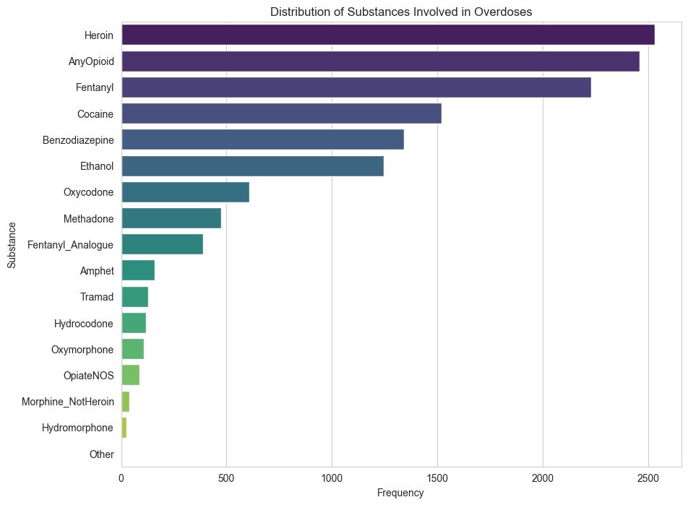

Slide 10
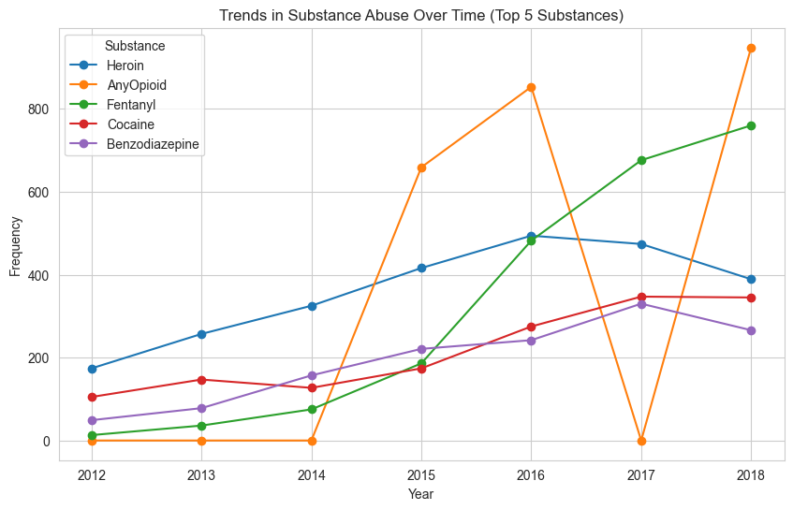

Slide 11
Feature Engineering
Created binary features for substance presence, binned age into categories, and one-hot encoded categorical features.

Slide 12
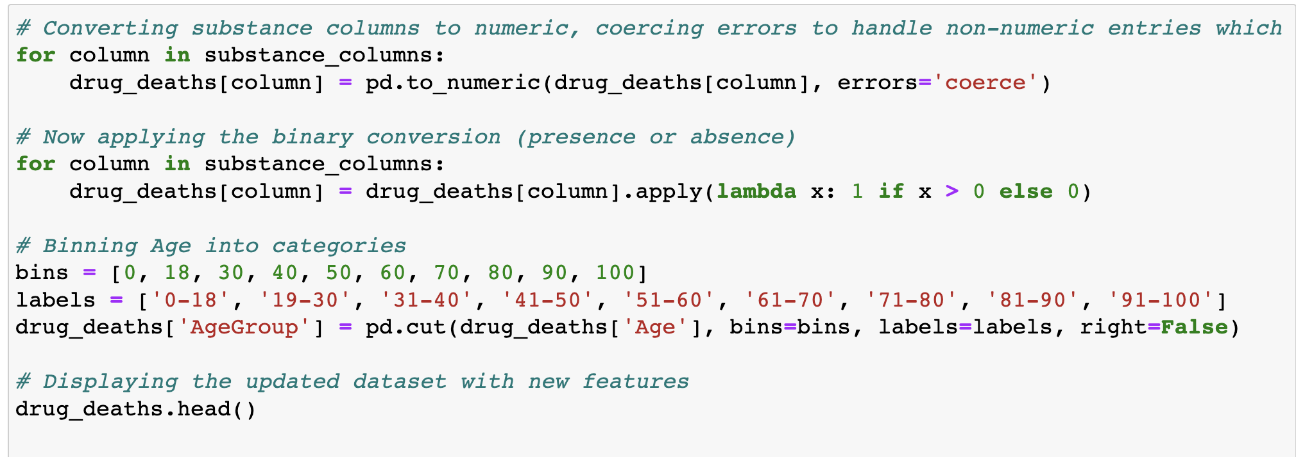
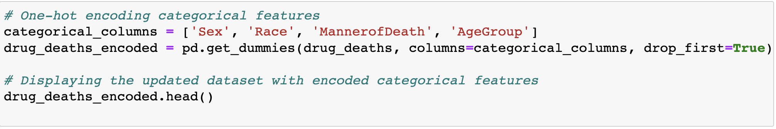

Slide 13
Modeling Overview
Employed Logistic Regression, Random Forest, and Support Vector Classifier to predict the presence of Fentanyl in drug overdose deaths.

Slide 14
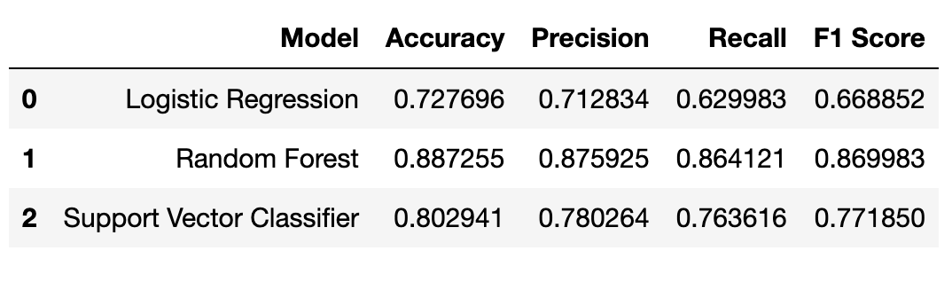

Slide 15
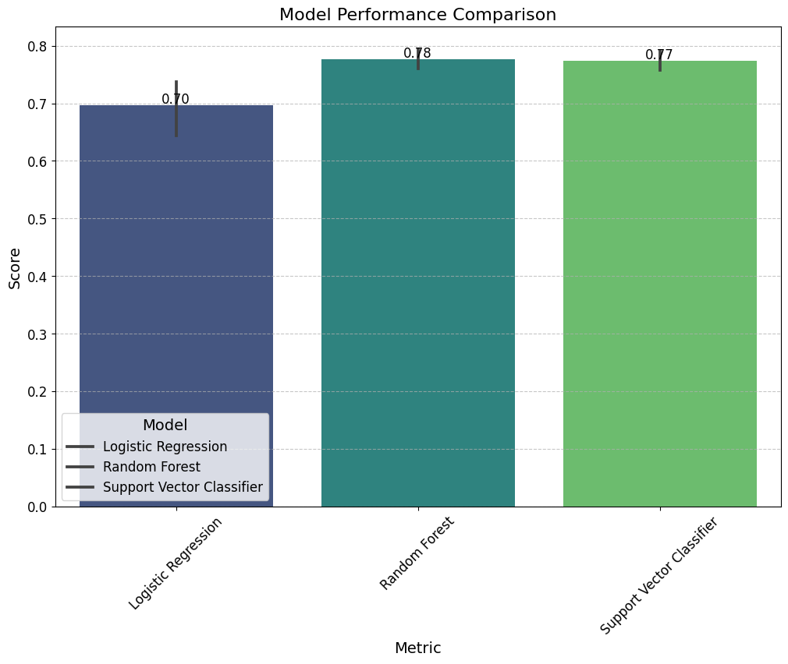

Slide 16
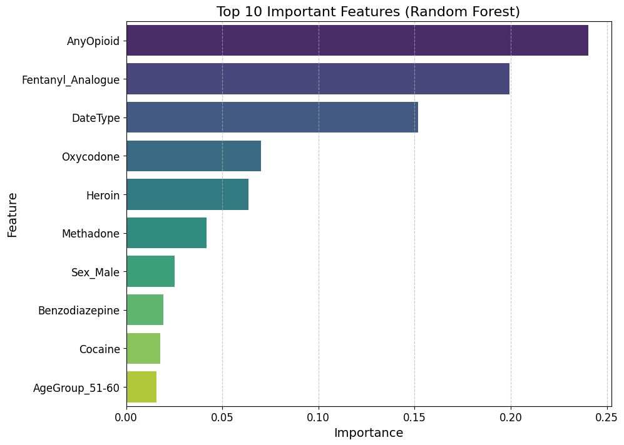

Slide 17
Model Performance
Evaluated models based on accuracy, recall, precision, and F1 score. (Visualization Placeholder)

Slide 18
Feature Importance
Identified key features contributing to the predictive power of the models. (Visualization Placeholder)

Slide 19
Best Model Selection
Random Forest emerged as the most promising model due to its high performance metrics and interpretability.

Slide 20
Recommendations
1. Age-Specific Interventions
2. Fentanyl Awareness Campaigns
3. Localized Community Programs

Slide 21
Further Research
Incorporate additional socioeconomic factors, evaluate existing programs, and explore localized patterns.

Slide 22
Conclusion
Our data-driven approach offers a pathway towards understanding and combating the drug overdose crisis.

Slide 23
Questions
Thank you for your attention! Any questions?

